Slide 1
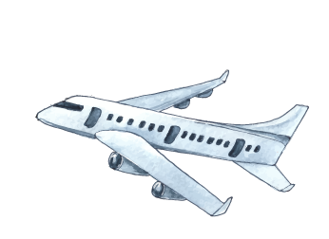
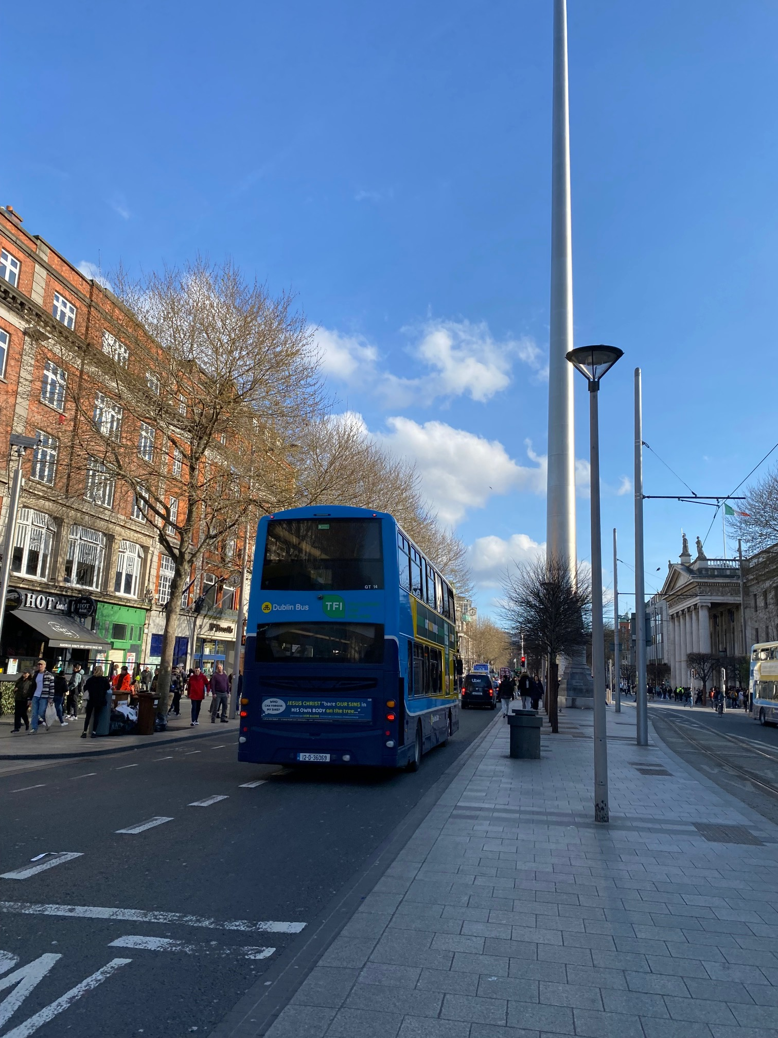
„Work experience as a new way to successful career and self-knowledge.“,
OA DMJ
Erasmus +
02. 04. 2023 – 15. 04. 2023 Dublin, Ireland
Aneta Šíblová

Slide 2
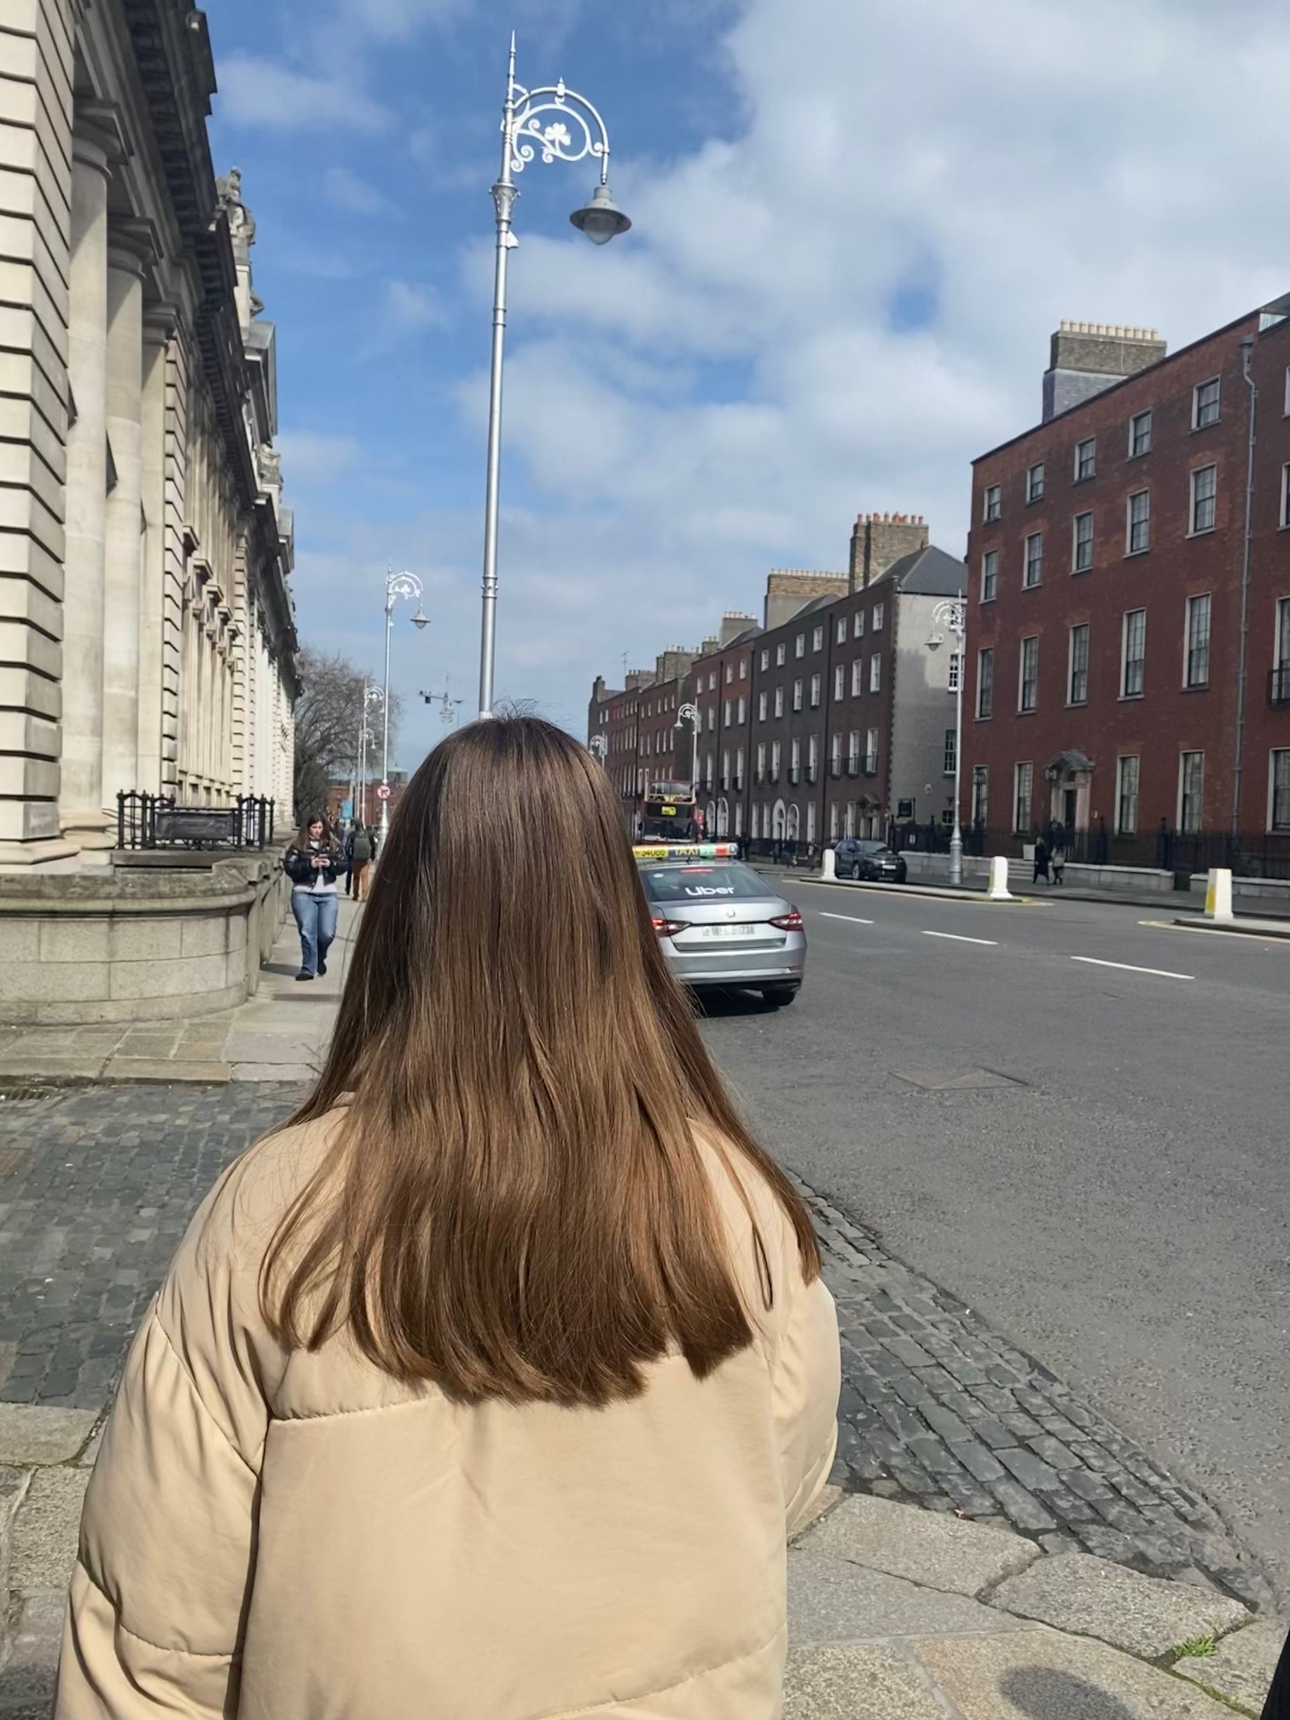
My first day in Irealnd
Host family
From the very first moment I just knew that I´m so lucky to stay with them... They have stolen a piece of my heart ☺
Travelling
ADC College
Firstly I was nervous because the system of travelling is different comparing to the ours but thanks to the meeting with ADC College it was no problem at all ☺
ADC College has a professional approach – they made everything look so easy and worth it ☺

Slide 3
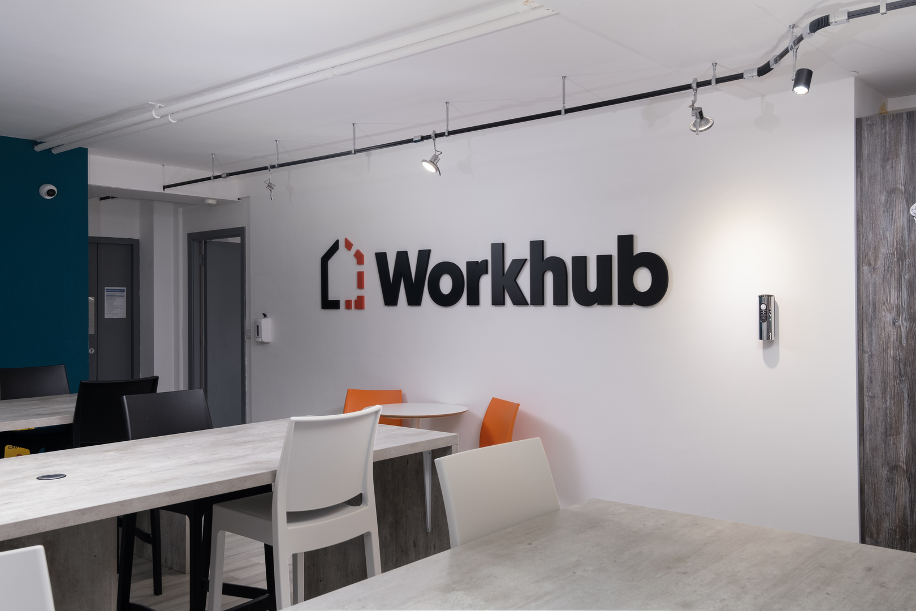
My work experience
51 Bracken Road
I have worked for Workhub – the company offering virtual and serviced offices, meeting rooms, dedicated desks,...

Slide 4
My activities and responsibilities
I was placed at reception where I took care about the post which was my the main task, then I was just checking the building, doing tasks I was told to, having small talks with users of the offices,...
Attitude of my supervisor
To be honest, I was so lucky to have Martina as my supervisor. She´s actually the walking definition of my vision of my future self. Friendly, always smiling, helpful, funny, hardworking and patient with me. There´s nothing I could reproach about.

Slide 5
Skills
I have learnt a lot but if I should choose the most useful ones, they would probably be:
Improvement of the communication
Knowledge about local mail system
Being flexible
Being more responsible

Slide 6
Contribution for my future career and study
Being a part of the Workhub for 2 weeks had opened my eyes and broadened my horizons. I have an opened mind about working or studying abroad, trying new things and still challenging myself. Maybe it´s a bit shocking but I still don´t really know what I want to do in the future but I´m so sure that this experience will influence my whole life.

Slide 7
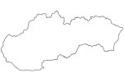
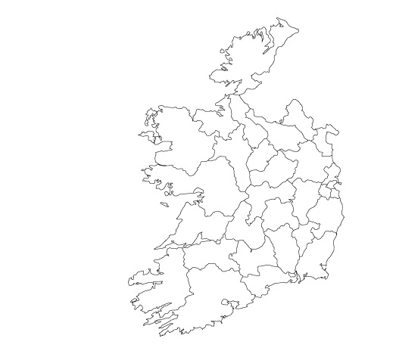
Diversity
Food
People
Fast food was on daily menu and they salt less than we do.
Everybody is smiling and so kind, even though they don´t know each other.
Multiculture
Transport
Dublin is so much more multicultural.
It´s so much easier and faster than in Slovakia.
Danger
Prices
It´s probably mix of more factors but I feel safer in Slovakia.
They are so much higher comparing them with the Slovak ones.

Slide 8
The message for future students in mobility:
Don´t worry
Don´t forget your smile
Try new things
There´s nothing to worry about because the ADC College will take care of everything.
Being positive is just a big +!
Don´t be afraid of unknown because you only live once... So make the unforgettable memories!
Have powerbank
Don´t waste your time
Enjoy nights
Dublin is a really big city so the Google Maps are a must-have... But because of them you can run out of battery very easily.
Time flies, so spend your days in the center, discover, visit historical places, have a good coffee, sing in the streets,...
Dublin is a city full of pubs where it lives at nights... They include the unique atmosphere you can find only in there!

Slide 9
Why would I recommend this work experience for other students?
If you have something in common with me (you like travelling, meeting new people, discovering, trying new things, you´re not afraid of unknown, responsible,...) then I would recommend you trying this programme – you won´t regret. It gave me new contacts, I´ve learnt new things, tried new things, visited new places and made the memories I´ll tell my children once about.
What I also really enjoyed was that I was „fighting for myself“. By that I mean that I was responsible for my actions – just me, myself and I ☺. It was really one of the best experiences I´ve ever went through. What´s also great is that you don´t have to pay for it. If you are a student then I don´t know what you´re still waiting for... Pack your things and go!

Slide 10
Thank you for your attention
“The world is a book and those who do not travel read only one page.”

